Slide 1
Cricket Players (Cricketers) Data Analysis CS 439 - Introduction to Data Science Course Project Professor: Gerard de Melo
Name: Smitkumar Patel NetID: Shp109 Group: 06 Recitation: 02 Email: shp109@rutgers.edu

Slide 2
DATA SETS
Cricket Players Data from ESPN: The data set contains information about the cricket players all over the world that played Tests, ODI, List A, First-class, T20I, and T20. There are a total of 90308 observations (rows) and 176 variables(columns). URL: https://data.world/raghav333/cricket-players-espn
IPL Cricket Players Data: The data set contains information about the cricket players that played IPL (Indian Premier League). There are a total of 497 observations (rows) and 7 variables(columns). URL: https://data.world/raghu543/ipl-data-till-2017/workspace/file?filename=Player.csv
Note: I left join ‘Cricket Players Data from ESPN’ and ‘IPL Cricket Players Data’. That means all records from ‘Cricket Players Data from ESPN’, and matched records from the ‘IPL Cricket Players Data’ on ‘Country’, ‘Birthdate’, and ‘Last_Name’. In addition, I created new column that contains binary labels ‘Play’ (player played IPL) and ‘Not Play’ (player did not play IPL).

Slide 3
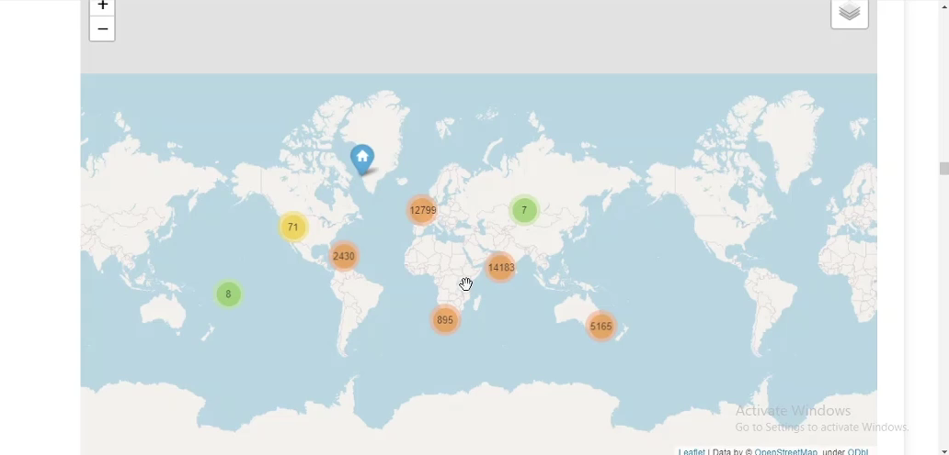
Number of players from country/city/county

Slide 4
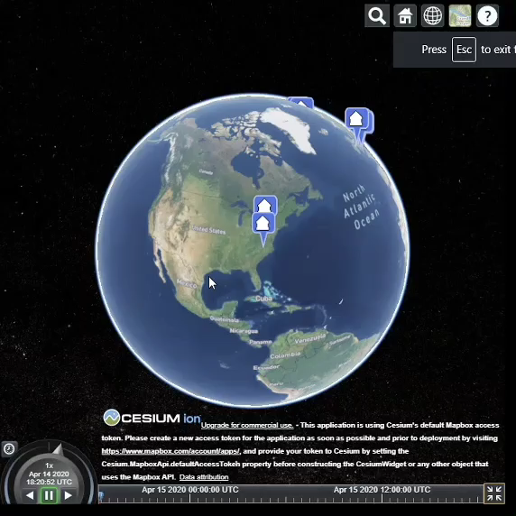
Top 10 batsmen and bowlers in Test, ODI, and T20

Slide 5
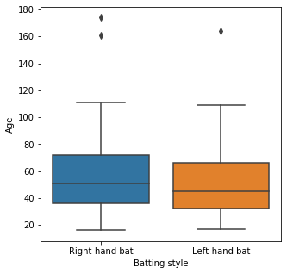
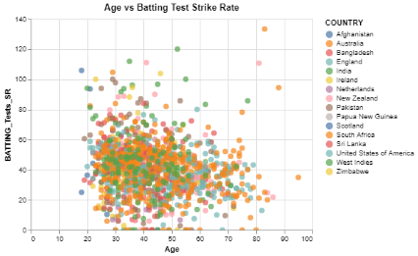
Age of players for various Batting style:
Age vs Batting Test Strike Rate (Test Run/Ball faced in Test):

Slide 6
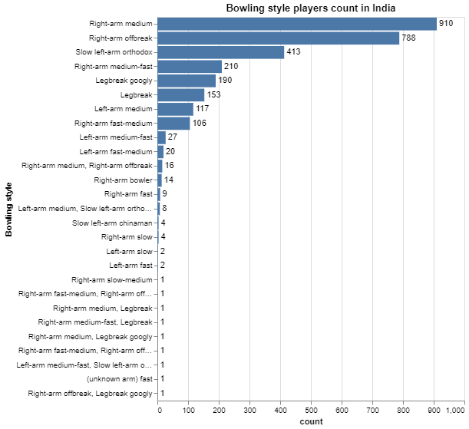
Bowling style players count in India

Slide 7
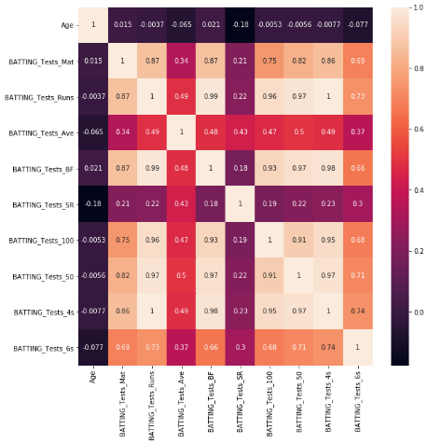
Test Batting Data Correlations

Slide 8
Machine learning algorithms to classify IPL status to be able to know player will play IPL or not
Note: All the accuracy and area under roc curve are acquire by 10-fold cross validation on training dataset.
Model | Average Accuracy | Average Area under Roc Curve | Note
LogisticRegression | 0.966788161 | 0.990200503
Support Vector Classification | -- | -- | Took too much time to fit training data
K-nearest neighbors | 0.981100088 | 0.994323267
Decision Tree | 0.989266064 | 0.994361751
Random Forest | 0.99040264 | 0.999867555
Stochastic Gradient Descent | 0.899986776 | 0.964317684
Gaussian Processes classification | -- | -- | Took too much time to fit training data
Naive Bayes | 0.821736747 | 0.937844178
Adaboost | 0.9989056 | 1
Gradient Boosting | 0.979584458 | 0.995913181
Histogram-Based Gradient Boosting | 0.99360147 | 0.999849177
Neural network models | 0.939638222 | 0.977137591

Slide 9
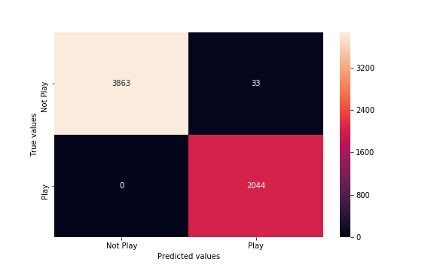
Voting Classifier model on Test Data
I used voting classifier to use majority vote to predict the IPL status because Random Forest, Adaboost, and Histogram-Based Gradient Boosting model have better accuracy and area under ROC curve.

Slide 10
Acknowledgments
https://geopy.readthedocs.io/en/stable/ https://nbviewer.jupyter.org/github/python-visualization/folium/blob/master/examples/MarkerCluster.ipynb https://python-visualization.github.io/folium/quickstart.html https://jupyter-gmaps.readthedocs.io/en/latest/tutorial.html https://altair-viz.github.io/ https://sandcastle.cesium.com/
https://elitedatascience.com/imbalanced-classes https://towardsdatascience.com/how-to-visualize-a-decision-tree-in-5-steps-19781b28ffe2 https://medium.com/@dtuk81/confusion-matrix-visualization-fc31e3f30fea https://github.com/justmarkham/scikit-learn-videos/blob/master/09_classification_metrics.ipynb https://github.com/justmarkham/scikit-learn-videos/blob/master/08_grid_search.ipynb
Libraries used:
Pandas, Geopy, Seaborn, Folium, Numpy, Matplotlib, Gmaps, Ipython, Altair, re
Scikit-learn libraries used:
train_test_split, classification_report, confusion_matrix, accuracy_score, resample, shuffle, metrics, cross_val_score, Tree, RandomizedSearchCV, GridSearchCV, plot_tree, enable_hist_gradient_boosting, RBF, LogisticRegression, Support Vector Classification (SVC), K-nearest neighbor(KNeighborsClassifiers), Decision Tree, Random Forest(RandomForestClassifier), Stochastic Gradient Descent(SGDClassifier), Gaussian Processes classification(GaussianProcessClassifier), Naive Bayes(GaussianNB), Adaboost(AdaBoostClassifier), Gradient Boosting(GradientBoostingClassifier), Histogram-Based Gradient Boosting(HistGradientBoostingClassifier), Neural network models(MLPClassifier)
Tools used:
Jupyter Notebook, Visual Studio Code
Programing languages used:
Python, HTML, JavaScript

